Slide 1
Sentiment Detection
with Keras, word embeddings and LSTM deep learning networks and flask
Done By:
- Louay AYADI
- Ghada MAHDI
2019-2020

Slide 2
Plan du travail:
Introduction:
Keras
Steps
Demonstration
Conclusion

Slide 3
Introduction
Web App
Deep learning
Nlp

Slide 4
II. Keras
Keras is a high-level neural networks API, written in Python and capable of running on top of TensorFlow, CNTK, or Theano.
It was developed with a focus on enabling fast experimentation. Being able to go from idea to result with the least possible delay is key to doing good research.
Use Keras if you need a deep learning library that:
Allows for easy and fast prototyping (through user friendliness, modularity, and extensibility).
Supports both convolutional networks and recurrent networks, as well as combinations of the two.
Runs seamlessly on CPU and GPU.

Slide 5
III. Steps
Get the data
Preprocess the data
Build the model
Train the model
Test the model
Predict something
Step 1
Step 2
Step 3
Step 4
Step 5
Step 6

Slide 6
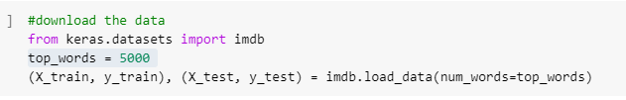
1- Get Data:
I have chosen to classify IMDB reviews as positive or negative for this example.
As a benefit the IMDB sample comes already with the Keras datasets library, so you don't have to download anything

Slide 7
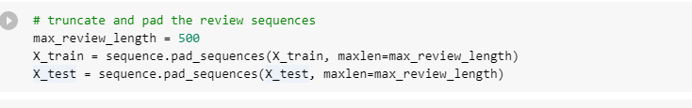
2- Preprocess Data:
Since the reviews differ heavily in terms of lengths we want to trim each review to its first 500 words.
We need to have text samples of the same length in order to feed them into our neural network.
If reviews are shorter than 500 words we will pad them with zeros. Keras being super nice, offers a set of preprocessing routines that can do this for us easily.

Slide 8
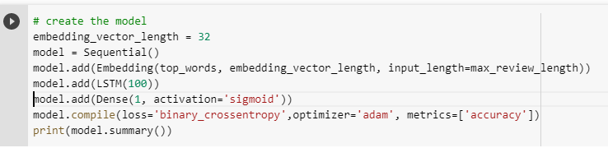
3- Build the model
The two most important things in our code are the following:
The Embedding layer
The LSTM Layer.

Slide 9
Embedding Layer:
The embedding layer will learn a word embedding for all the words in the dataset.
It has three arguments
The input_dimension in our case the 500 words.
The output dimension aka the vector space in which words will be embedded. In our case we have chosen 32 dimensions so a vector of the length of 32 to hold our word coordinates.

Slide 10
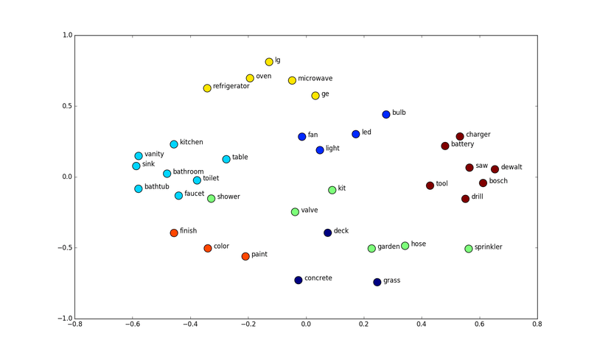
Embedding Layer:
How can you imagine what an embedding actually is? Well generally words that have a similar meaning in the context should be embedded next to each other. Below is an example of word embeddings in a two-dimensional space:

Slide 11
LSTMs
Recurrent neural networks are networks that are used for "things" that happen recurrently so one thing after the other (e.g. time series, but also words).
Long Short-Term Memory networks (LSTM) are a specific type of Recurrent Neural Network (RNN) that are capable of learning the relationships between elements in an input sequence. In our case the elements are words.
So our next layer is an LSTM layer with 100 memory units.
Finally at the end we have a dense layer with one node with a sigmoid activation as the output.

Slide 12
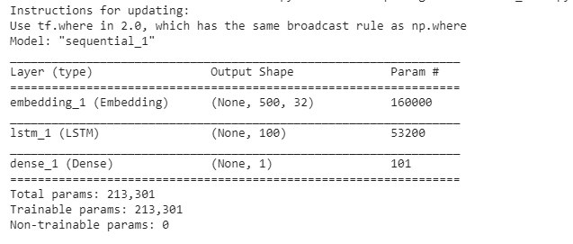
After defining the model Keras gives us a summary of what we have built. It looks like this:
.

Slide 13
4 - Train the model
We will make the model see the dataset 3 times, defined by the epochs parameter.
The batch size defines how many samples the model will see at once - in our case 64 reviews.

Slide 14
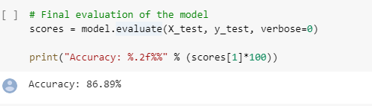
Step 5: Test the model
Once we have finished training the model we can easily test its accuracy

Slide 15
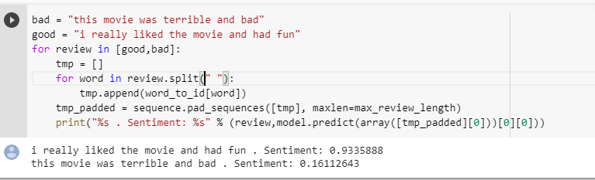
Step 6: Predict something
In order to do so we need to translate our sentence into the corresponding word integers and then pad it to match our data.
We can then feed it into our model and see if how it thinks we liked or disliked the movie.

Slide 16
V. Conclusion
So we have built quite a cool sentiment analysis for IMDB reviews that predicts if a movie review is positive or negative with 87% accuracy.
We can improve the model through increasing the training dataset or adding more layers to the neural network

Slide 17
Thanks !

